Slide 1
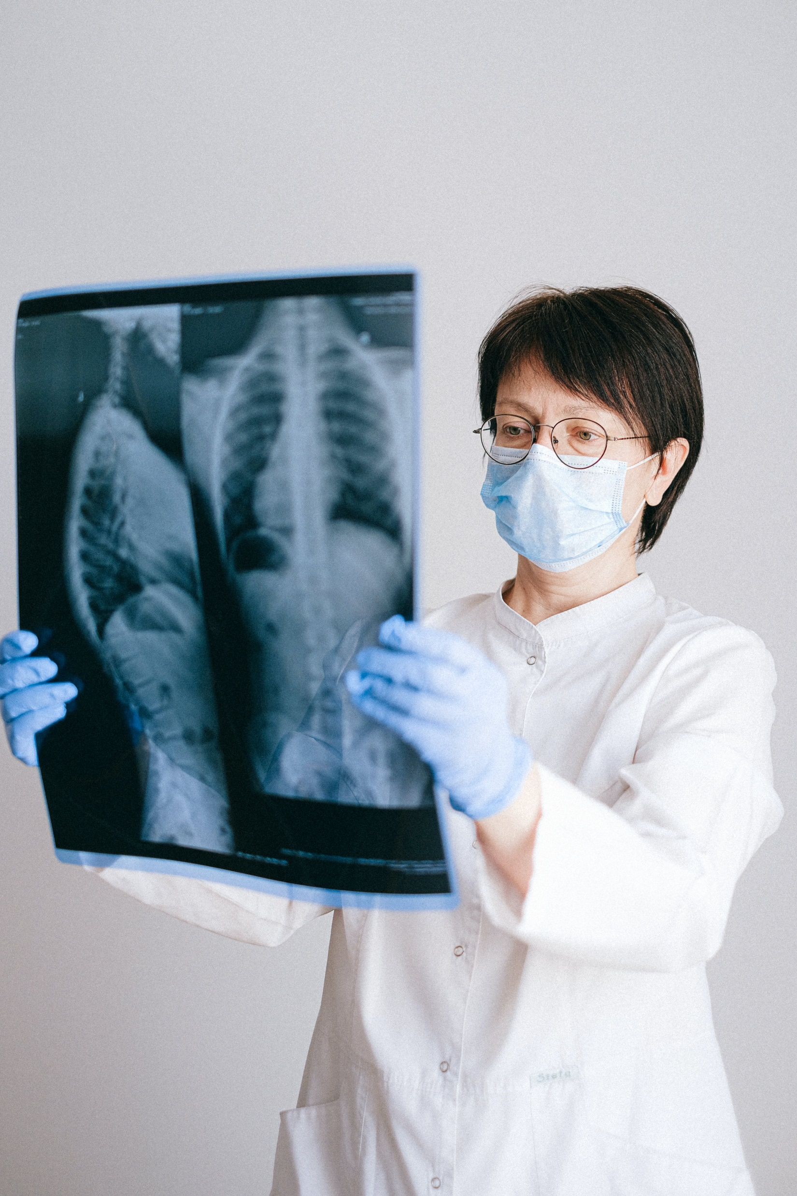

Modernizing Pneumonia Detection:
Chest X-Ray Analysis
With
Deep Learning
- Rupesh More

Slide 2
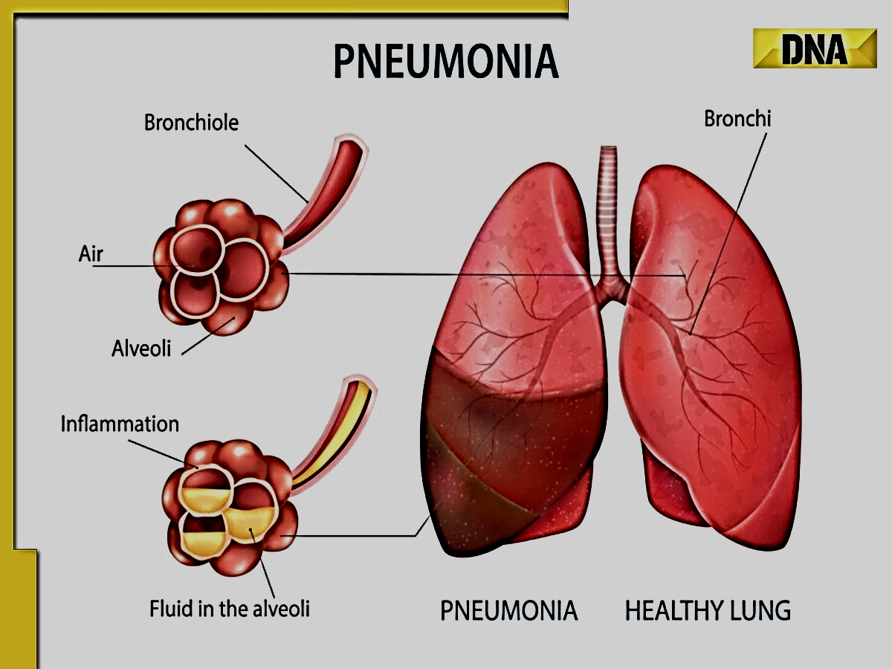
Introduction to the significance of pneumonia detection :
Pneumonia is a common lung infection that affects millions of people worldwide. It can be caused by bacteria, viruses, or fungi and can range from mild to severe. Early diagnosis and treatment are crucial for preventing complications. Chest X-rays are a readily available and inexpensive imaging technique used to diagnose pneumonia. However, interpreting chest X-rays can be challenging, especially for subtle cases. This is where AI-powered chest X-ray pneumonia detection models come in.

Slide 3
Objectives :
Develop a deep learning model to automatically detect pneumonia from chest X-ray images.
Improve the accuracy, sensitivity, and specificity of pneumonia diagnosis compared to human radiologists.
Reduce the workload of radiologists and enable faster diagnosis of pneumonia.

Slide 4
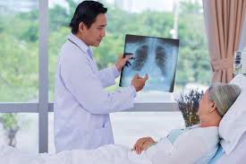
Chest X–Ray in pneumonia diagnosis :
Pneumonia can be difficult to diagnose accurately, especially in the early stages when symptoms are mild and non-specific.
Chest X-rays are a common diagnostic tool used to detect pneumonia, but they can be challenging to interpret accurately, especially for inexperienced radiologists.

Slide 5
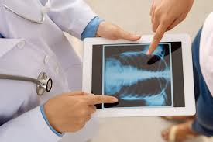
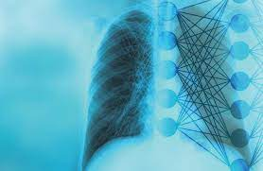
Traditional Method VS Deep Learning
Traditional Method
Deep Learning
Radiologists visually inspect chest X-rays to detect pneumonia, but this can be subjective and prone to errors.
Chest X-rays are evaluated by deep learning-based approaches to detect signs of pneumonia with high accuracy.

Slide 6
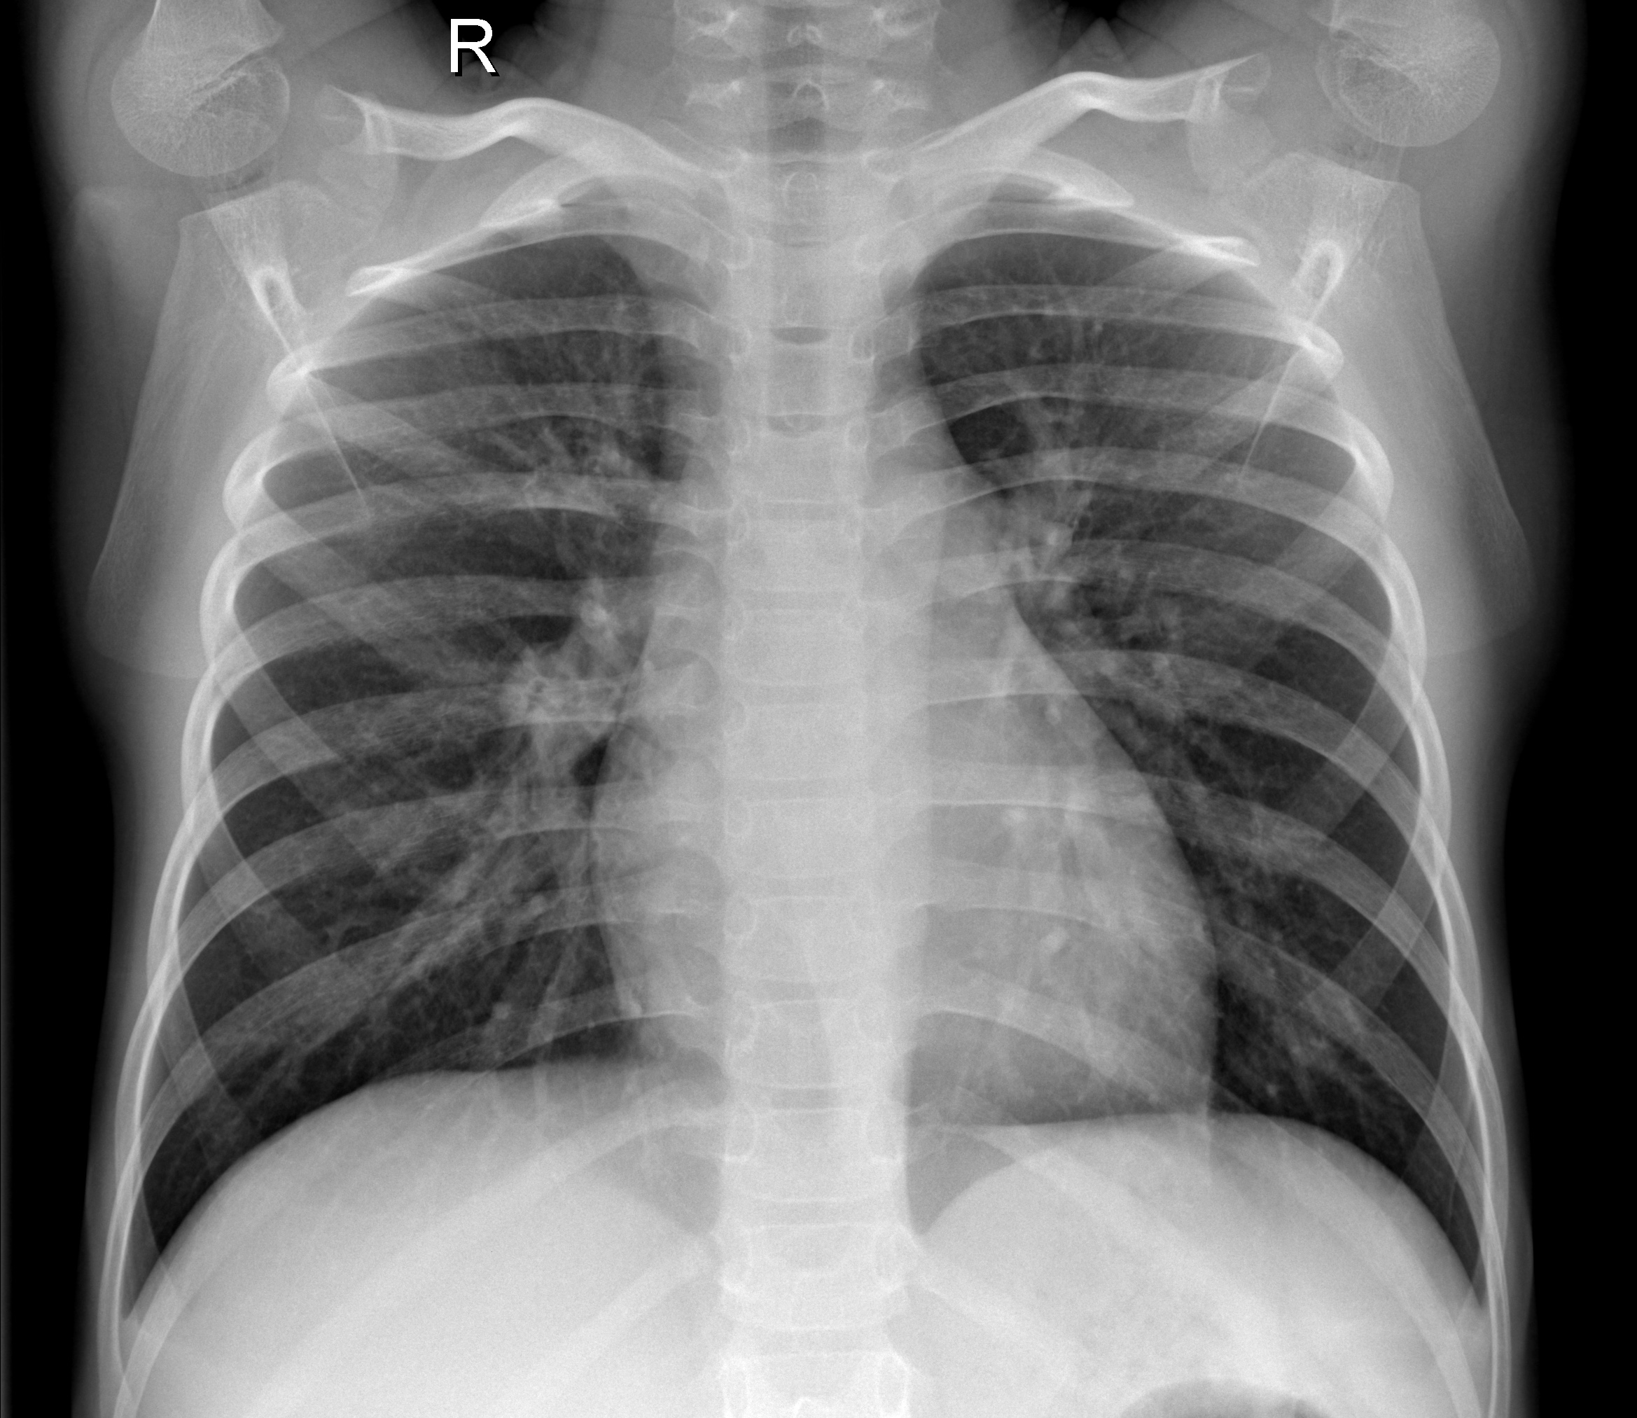
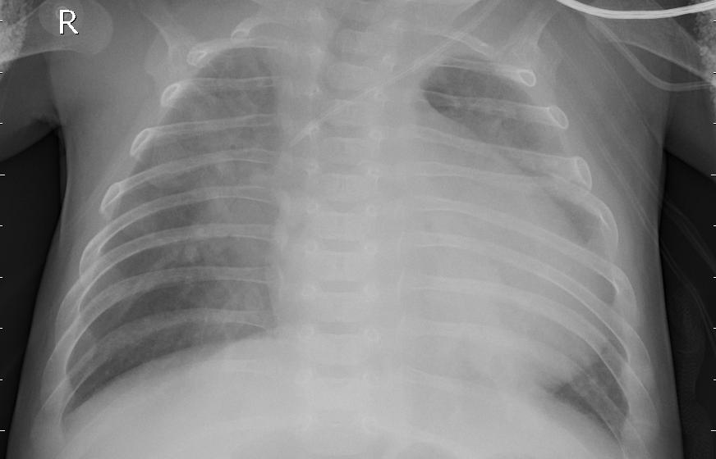
Normal X-ray VS Pneumonia Infected X-ray

Slide 7
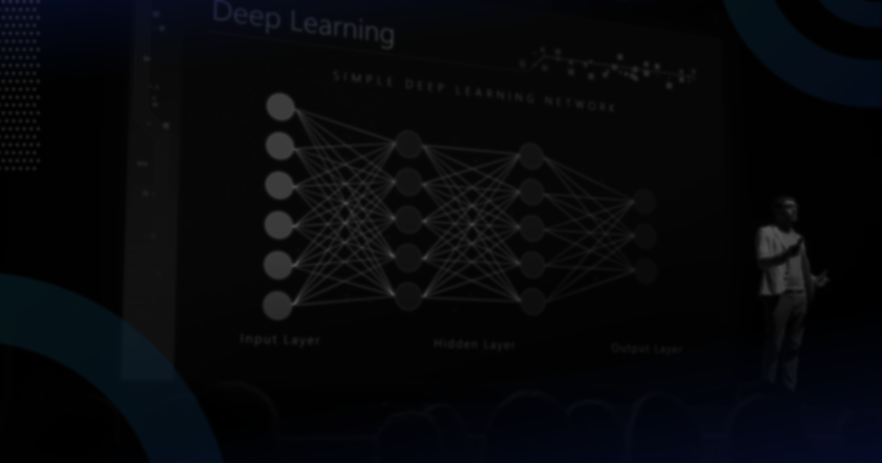
What is Deep Learning ?
Deep learning is a method in artificial intelligence (AI) that teaches computers to process data in a way that is inspired by the human brain. Deep learning models can recognize complex patterns in pictures, text, sounds, and other data to produce accurate insights and predictions. You can use deep learning methods to automate tasks that typically require human intelligence, such as describing images or transcribing a sound file into text.
Advantage of deep learning in medical imaging analysis:
Deep learning algorithms can process large amounts of medical imaging data quickly and accurately, enabling faster and more reliable diagnosis of diseases like cancer and pneumonia.

Slide 8
1. Data Acquisition
2. Preprocessing
3. Model Development
4. Training Validation
5. Testing and Evaluation
Methodology

Slide 9
Data Collection and Preprocessing :
Data source :
Kaggle
Link : https://www.kaggle.com/datasets/paultimothymooney/chest-xray-pneumonia
Importance of high-quality data for training the deep learning model:
The accuracy of the deep learning model depends on the quality and quantity of the data used to train it. High-quality data that is representative of the population being diagnosed is essential for achieving high accuracy.
Preprocessing:
Preprocessing steps such as image normalization and augmentation can help improve the quality of the data and increase the accuracy of the deep learning model.

Slide 10
Data
100%
Train
80%
Model
80%
Validation
20%
Test
20%
Data Partition
Total Images : 5856
1. Normal : 1583
2. Pneumonia : 4273
Train : Total Images * 80% = 4685
1. Model : Train * 80% = 3748
2. Validation : Train * 20% = 937
Test : Total Images * 20% = 1171

Slide 11
Deep learning model architecture :
The deep learning model for pneumonia detection is typically a “Convolutional Neural Network” (CNN) that is trained on a large dataset of chest X-ray images.
The CNN architecture is especially useful for image recognition and image classification, as well as other computer vision tasks because they can process large amounts of data and produce highly accurate predictions. CNNs can learn the features of an object through multiple iterations, eliminating the need for manual feature engineering tasks like feature extraction
The CNN consists of multiple layers that extract features from the input images and classify them as either normal or showing signs of pneumonia.

Slide 12
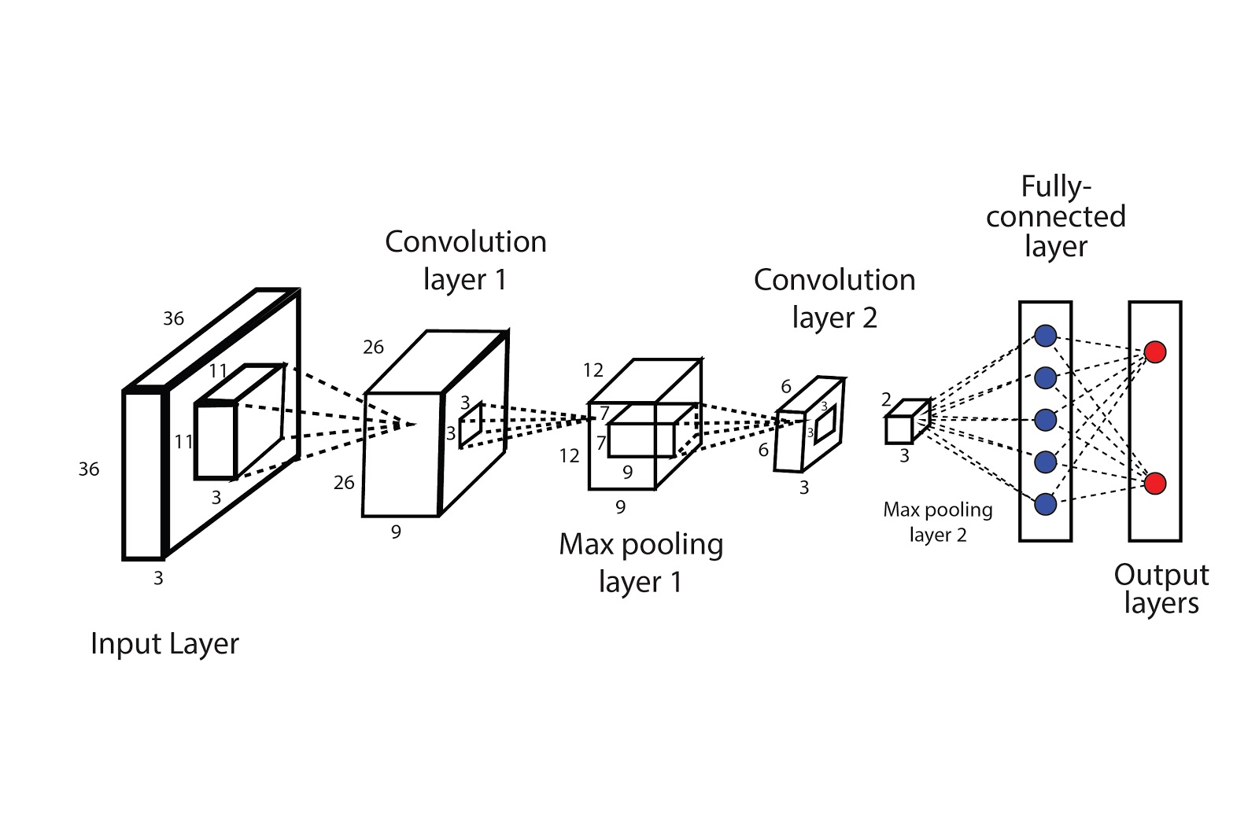
Fig. Architecture of CNN model
1. Input layer: This is the first layer of the CNN where the input data, such as an image, is fed into the network.
2. Convolutional layer: This layer applies a set of filters to the input data to extract features and create feature maps.
3. Pooling layer: This layer reduces the spatial dimensions of the feature maps, which helps in reducing the computational complexity and controlling overfitting.
4.Flattening layer: This layer flattens the output of the previous layers into a single vector, which is then fed into the fully connected layer.
5. Fully connected layer: This layer connects all neurons from the previous layer to the next layer, and is responsible for learning the non-linear combinations of features.
6. Output layer: This is the final layer of the CNN that produces the output predictions based on the learned features from the previous layers.

Slide 13
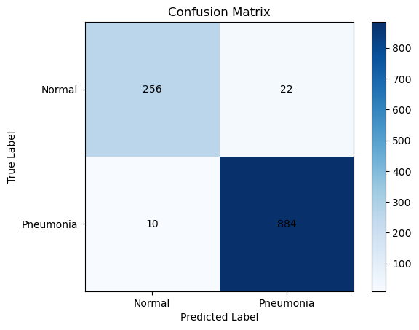
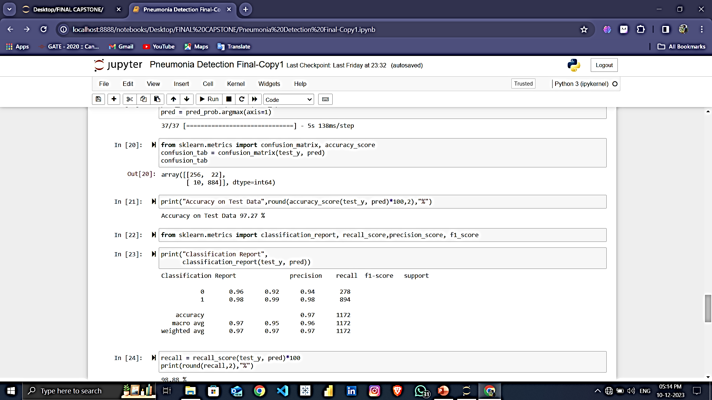
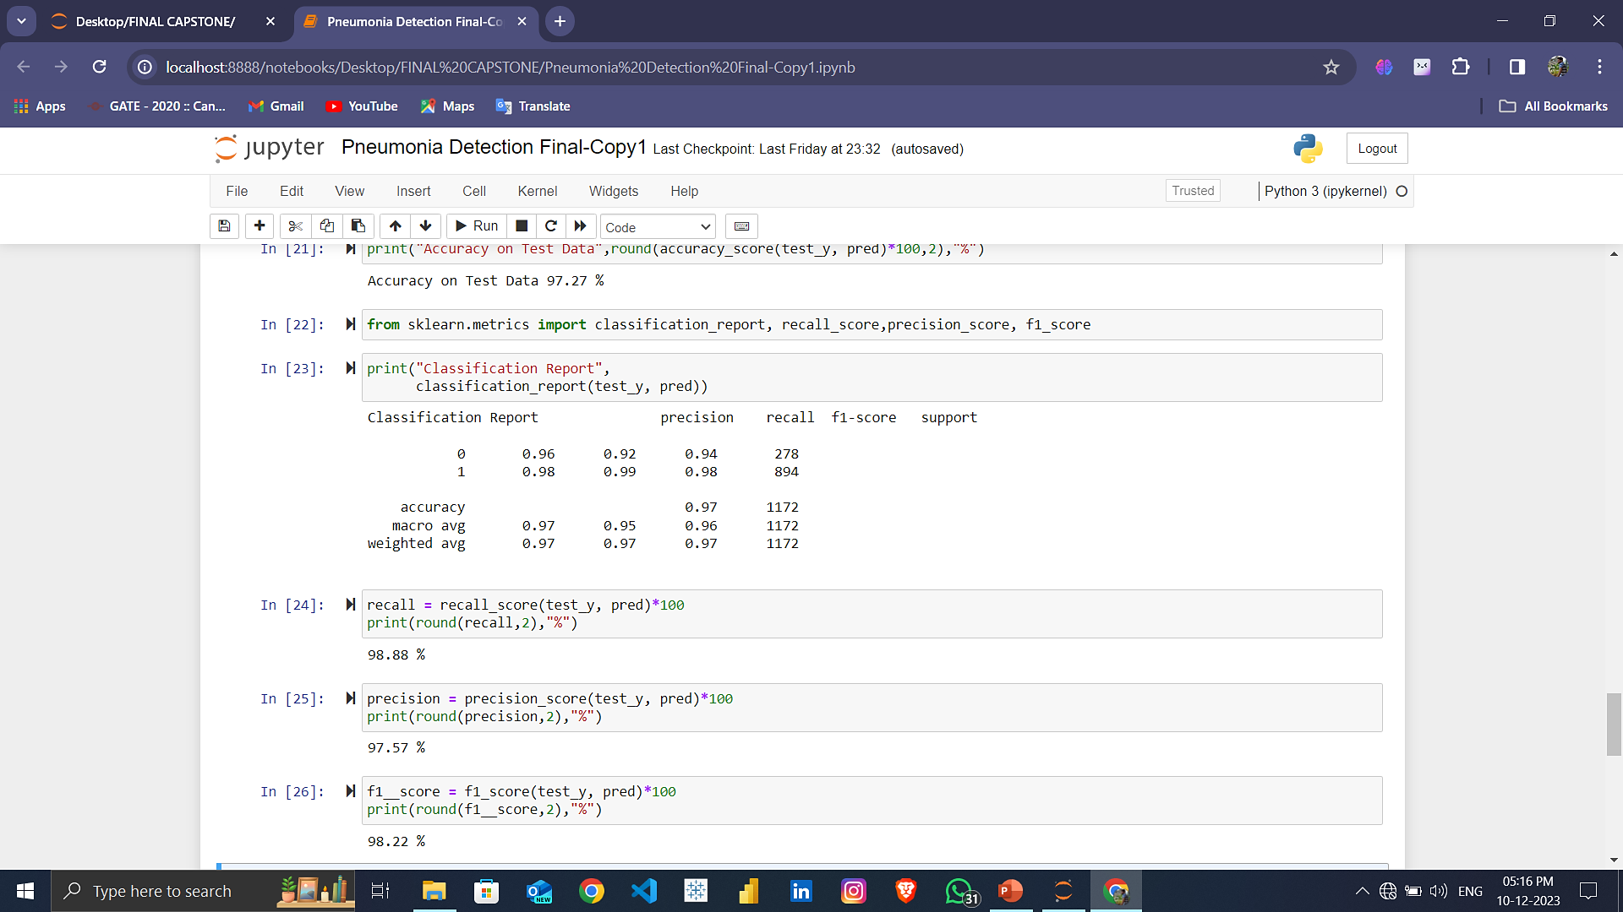
Performance Evaluation :
The results of the proposed model are estimated using various metrics, including accuracy, precision, F1-score, and recall
Confusion Matrix
Accuracy, Recall score , Precision, F1- Score

Slide 14
Model Evaluation Table
SR.NO | Metrics | Score (%)
1. | Accuracy | 97.27%
2. | Precision | 97.57%
3. | Sensitivity | 98.88%
4. | Specificity | 92%
5. | F1- Score | 98.22%

Slide 15
Advantages :
Early intervention: Early diagnosis of pneumonia allows for prompt treatment, improving patient outcomes and reducing the risk of complications.
Improved patient care: Accurate pneumonia detection can guide treatment decisions, leading to better patient care and reduced healthcare costs.
Infection control: Early identification of pneumonia can help prevent the spread of the infection to other patients and healthcare workers.

Slide 16
Limitations and Challenges :
One of the challenges of implementing deep learning models in clinical settings is the lack of interpretability and transparency. This limits the ability of clinicians to understand how the model arrives at its diagnosis and may impede its adoption in clinical practice.

Slide 17
Conclusion
Deep learning models have demonstrated promising performance in detecting pneumonia from chest x-ray images, achieving high accuracy, sensitivity, and specificity.
Deep learning models can automatically analyze chest X-ray images, reducing the workload for radiologists and enabling faster diagnosis.
Deep learning models can achieve higher accuracy than traditional methods, especially in subtle or atypical cases of pneumonia.
Deep learning models provide consistent and objective analysis, minimizing the impact of human bias and variability.

Slide 18
Thank You !

